Slide 1
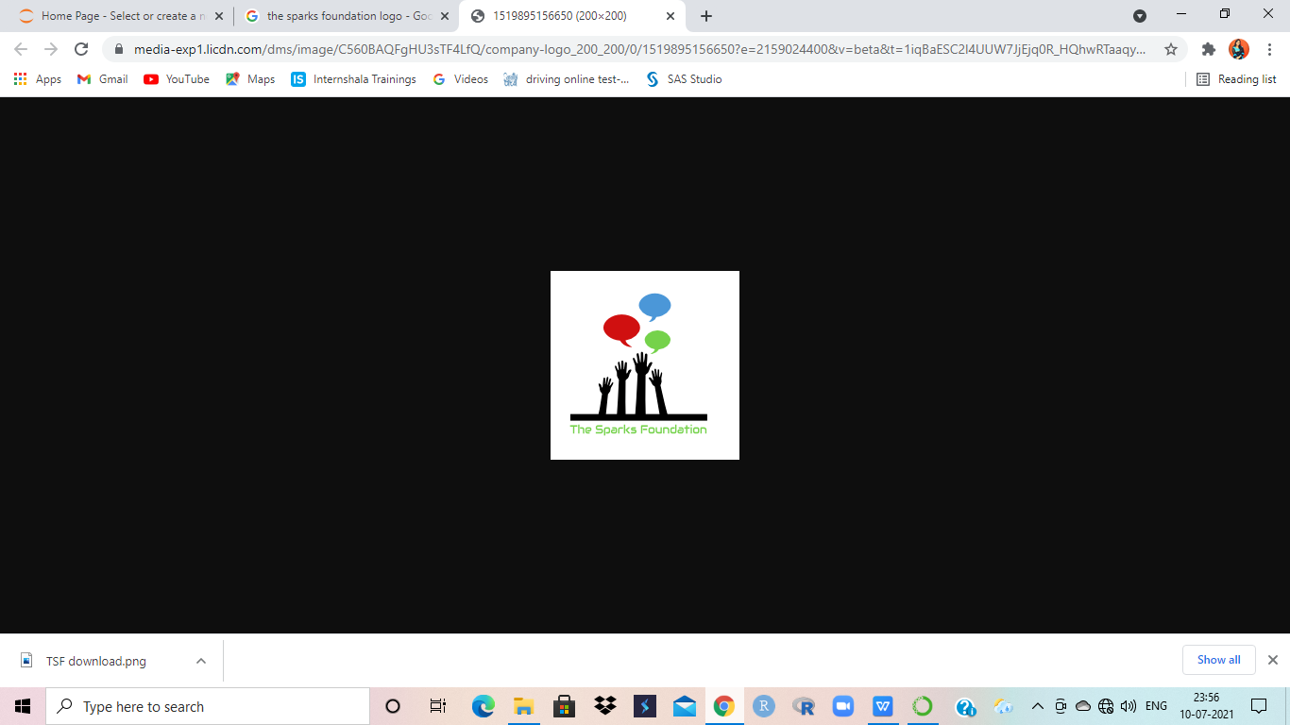
THE SPARKS FOUNDATION GRIP-JULY’2021 (Graduate Rotational Internship Program)
TASK 01 : RECRUITMENT ARTICLE AND POSTS ON SOCIAL MEDIA
BY : ALEENA VADAKKEDATHU SHAJAN
(DATA SCIENCE AND BUSINESS ANALYTICS INTERN)
At THE SPARKS FOUNDATION

Slide 2
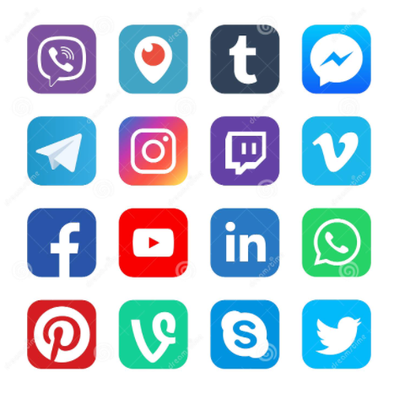
DIFFERENT WAYS OF USING THE SOCIAL MEDIA FOR RECRUITING

Slide 3
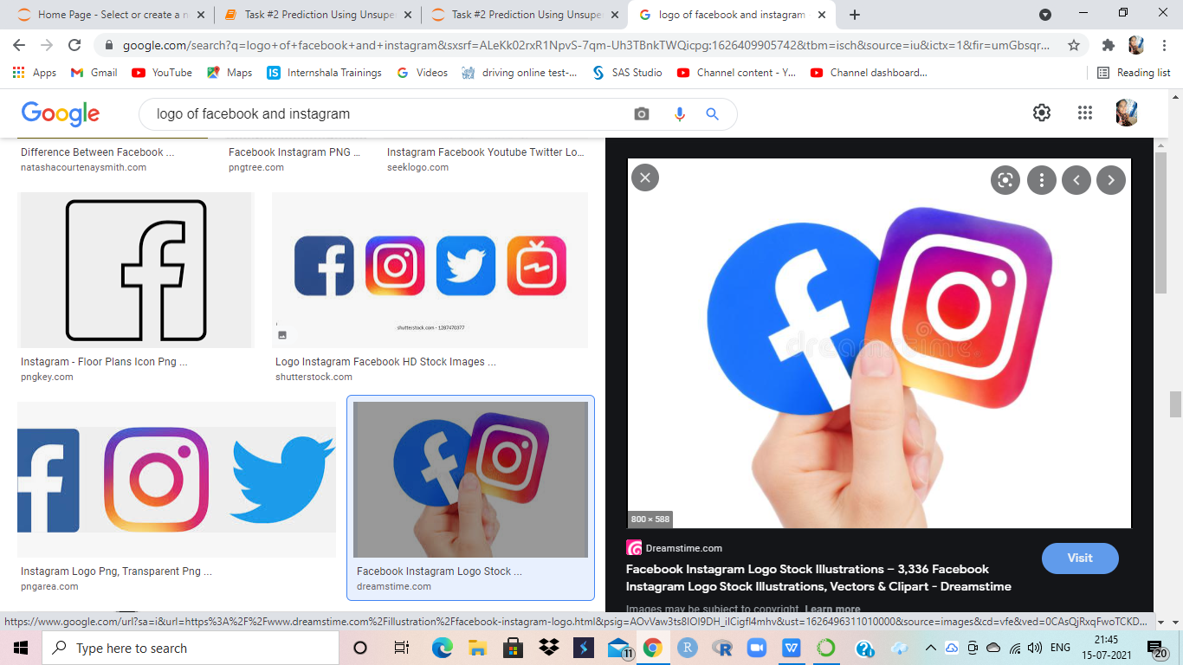
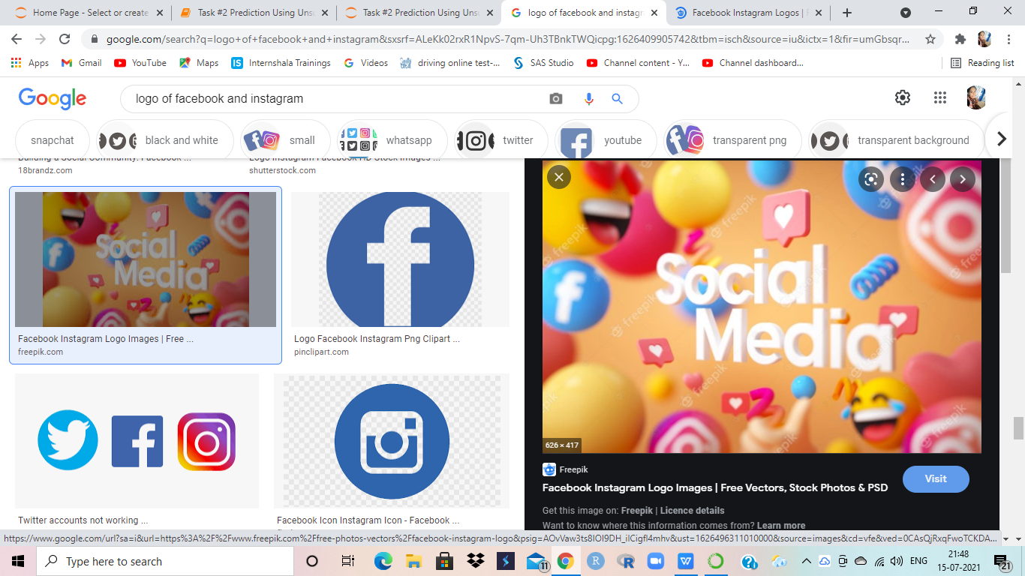
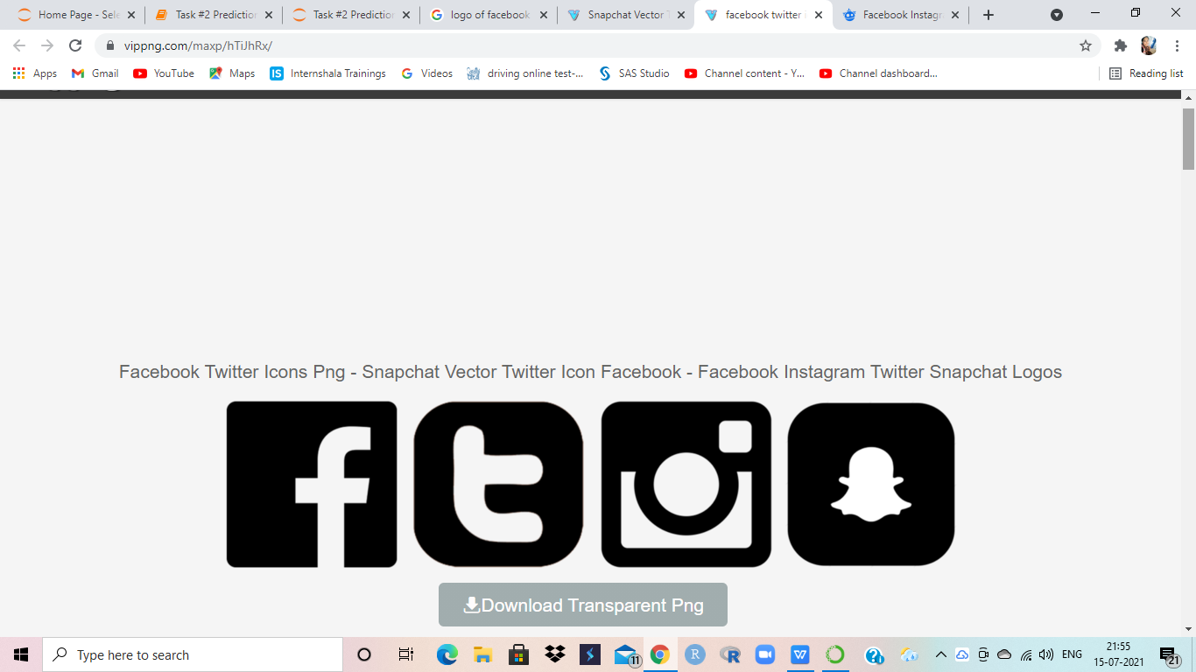
SOCIAL SITES
Identifying the potential candidates on various social media sites such as LinkedIn,Naukari,TimesJob etc.
Messaging or contacting the potential candidate for the respective role via gmail or phone.
Post the success stories or reviews of people on your organization’s social media sites especially on Google.
Also post the employees’s positive feedback on the organization’s page.
Create videos that highlight the trend,culture,outline and work atmosphere of the company.

Slide 4
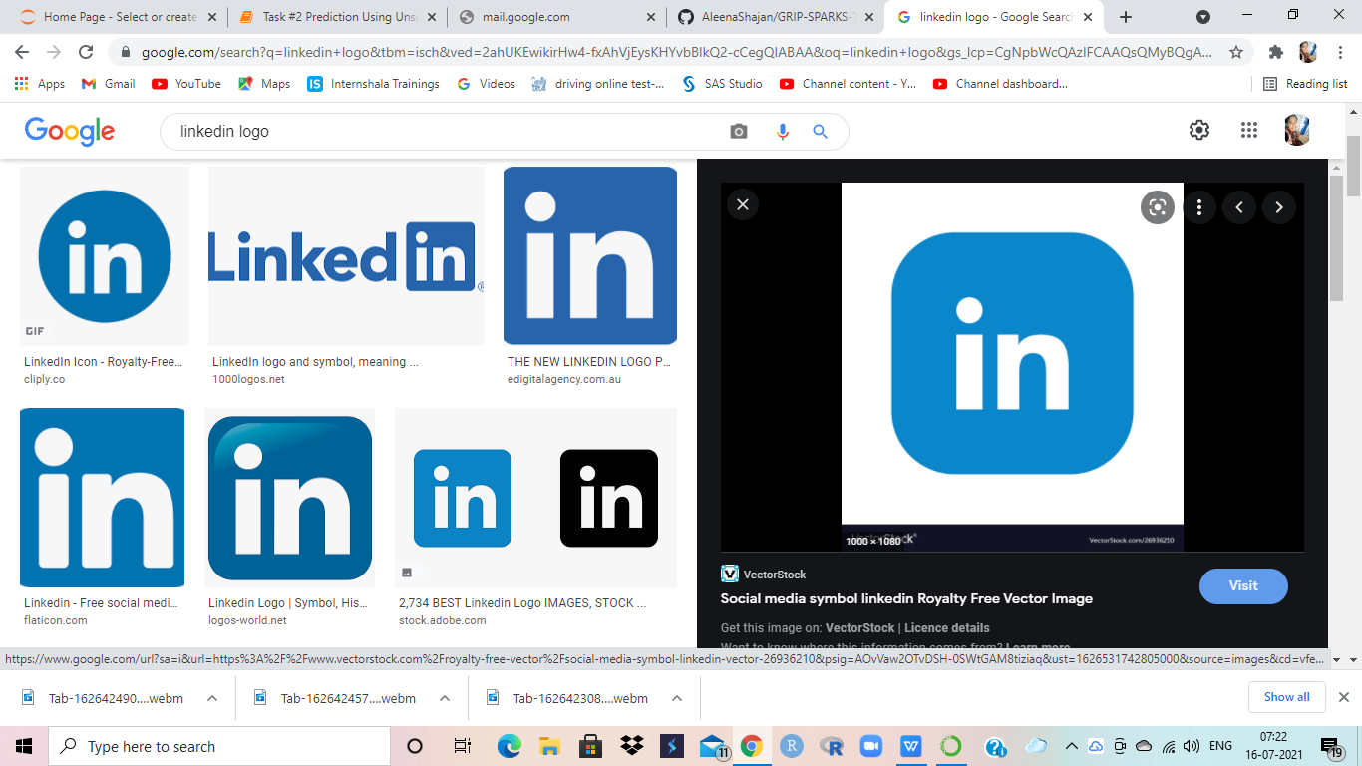
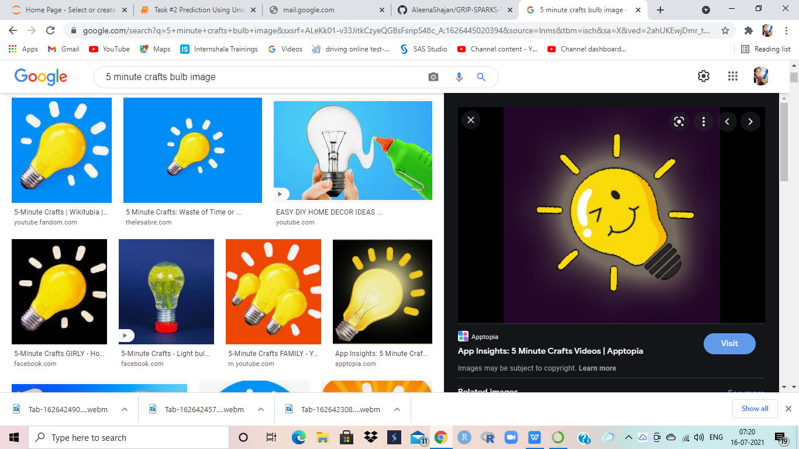
TIPS FOR EFFECTIVE SOCIAL RECRUITING

Slide 5
INCLUDE YOUR STAFF DURING THE RECRUITING PROCESS.
INTRODUCE NEW SCHEMES TO THE EMPLOYEE THAT FASCINATE THEM TO CHOOSE YOUR COMPANY.

Slide 6
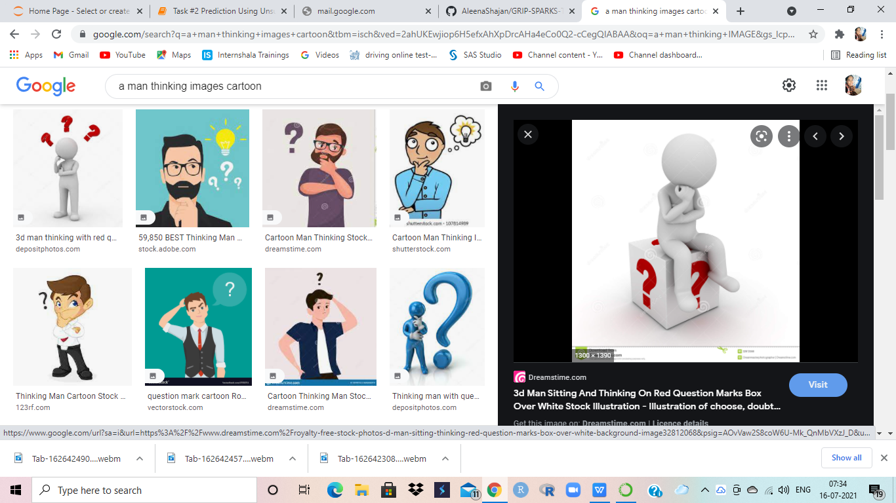
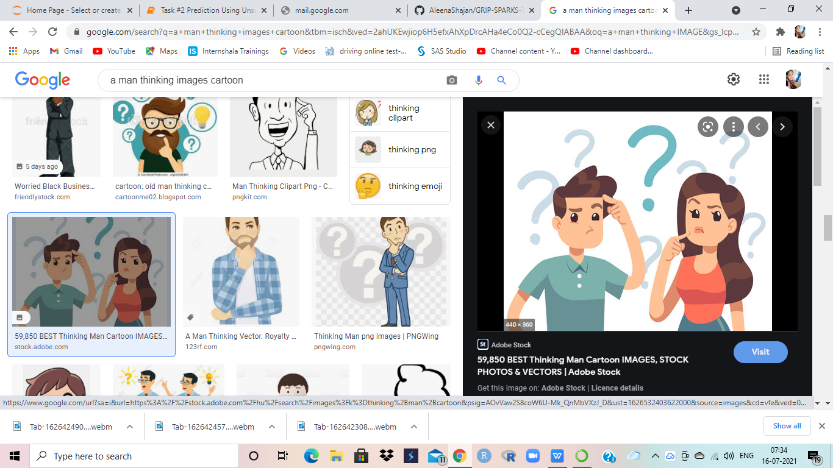
HOW TO GET REFERRALS FROM PEOPLE ON LINKEDIN [ ] ???

Slide 7
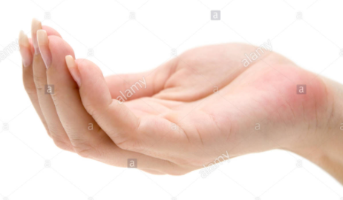
FIND THE RIGHT PERSON
SEND THE DETAILS VIA MESSAGE
FOLLOW-UP

Slide 8
THANK YOU
PLEASE DO SUPPORT MY WORKS ON THE FOLLOWING SOCIAL MEDIA SITES:
FACEBOOK: https://www.facebook.com/aleenav99
INSTAGRAM: _one_way_lassie_
LINKEDIN: https://www.linkedin.com/in/aleena-vadakkedathu-shajan-124576205
GITHUB: https://github.com/AleenaShajan

